Slide 1

Workplace Accident Detection and Reporting System
Enhancing Workplace Safety with Smart Wearables
Presented by Team HYPERTRONICS
Engineering Design Project 2025

Slide 2
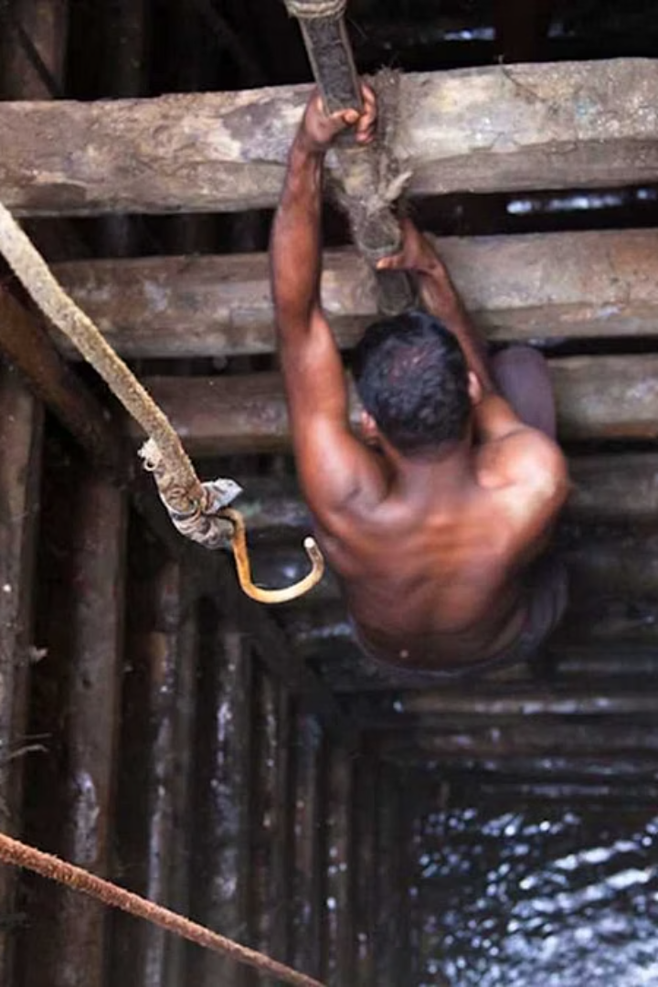
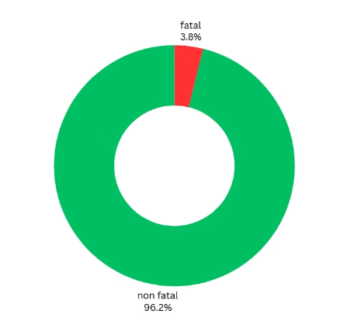


Problem Overview: Workplace Safety Challenges in Sri Lanka
Accident Statistics
Incident Detection Issues
⚠️ Unnoticed or Unreported Incidents:
Many workplace accidents are not immediately seen or reported.
Especially common in isolated areas or during night shifts.
🕒 Delayed Emergency Response:
Lack of instant detection leads to slower medical attention.
Time lost increases the risk of permanent injury or death.
📉 Impact on Survival and Recovery:
Delays in response can turn treatable injuries into severe conditions.
resources: www.labourmin.gov.lk
Reduces chances of full recovery and increases long-term costs.
Human Cost
Workplace fatalities are preventable, and no one should lose their life while fulfilling their professional duties.

Slide 3
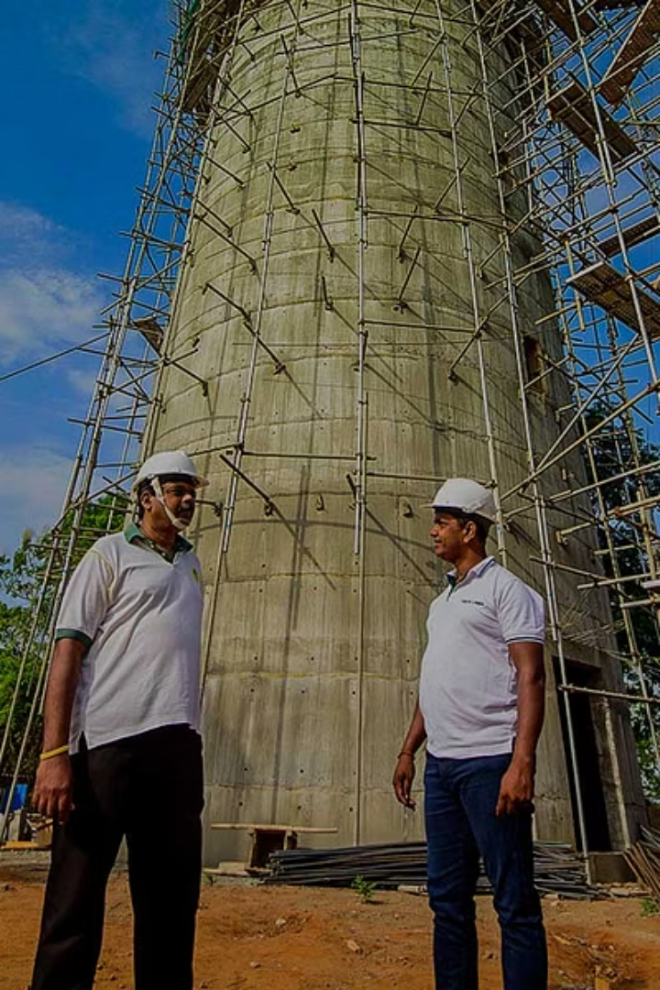



The Need for a Safety System
Limitations of Current Systems
Importance of Automation
Existing safety protocols largely rely on manual or human reporting
The solution must be automatic and proactive to detect accidents instantly
which delays reaction times and often misses critical incidents.
minimizing response time and enabling timely intervention.
Enhancing Prevention and Response
Our product aims to.
🛑 1. Prevent Accidents through Situational Awareness
Sends early warnings about poor air quality so workers can take action before health risks arise.
⚡ 2. Enable Rapid Emergency Response via Real-Time Alerts
When a fall is detected, the system immediately sends an alert to a responsible person or healthcare provider, ensuring a rapid response.

Slide 4
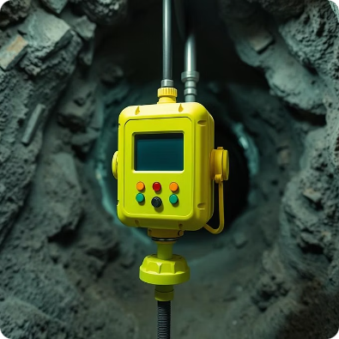
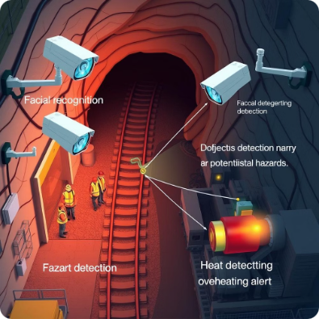

Alternative Approaches
Fixed Environmental Monitoring System
AI-Based CCTV Monitoring System
Install fixed sensors in mine shafts, tunnels, or confined spaces to monitor gases and air quality.
Integrate AI with existing CCTV systems to detect abnormal behaviors (e.g., falls, inactivity).
Pros:
Pros:
Continuous environmental monitoring
Uses existing infrastructure
No need for wearables
No hardware on the worker
Cons:
Cons:
Limited to the sensor’s coverage area
Needs clear camera views
May not detect individual emergencies
Can struggle in poor lighting or cluttered environments

Slide 5
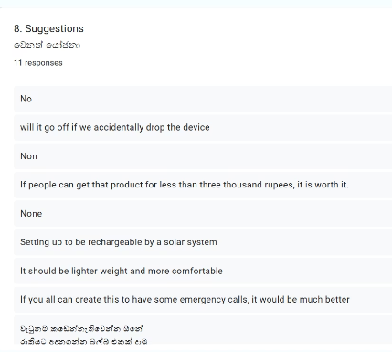
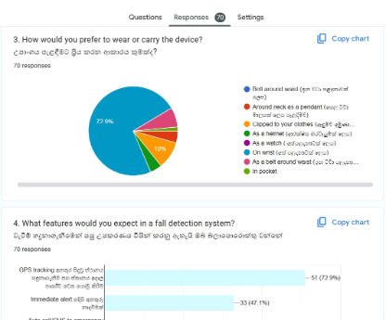


Stakeholder Feedback
We held discussions with some professional mine owners, workers, safety engineers, civil engineers, health officers, industry consultants, and members of the public to gather valuable insights and feedback
Design Preferences
Functionality
Battery and Usability
Users emphasized the need for a lightweight and discreet device for daily wearability.
customizable alerts for different gases(oxygen,methane,…)
Long battery life
send emergency SMS alerts

Slide 6
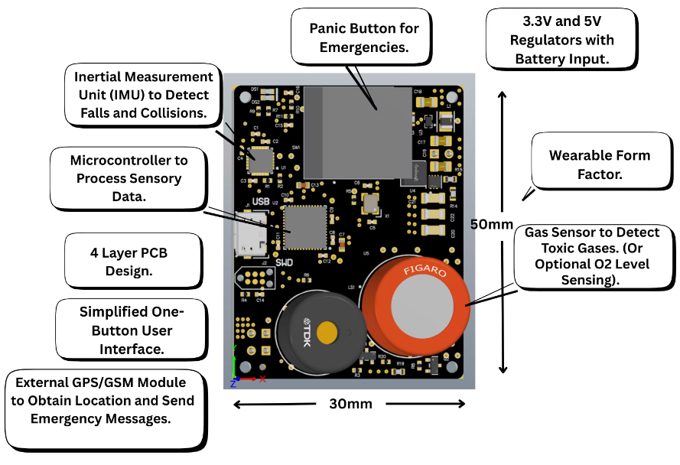
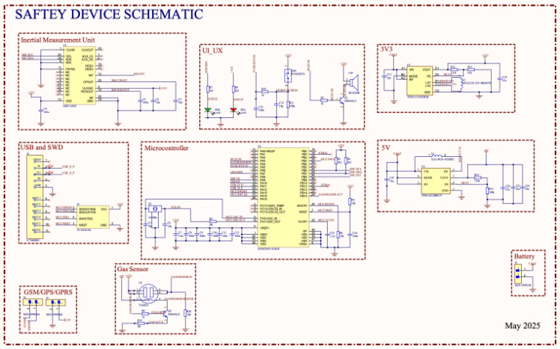

PCB Design: Compact and Efficient Electronics

Slide 7
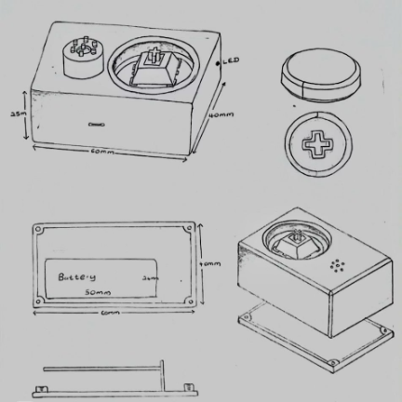
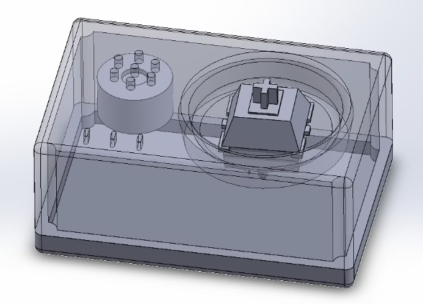

Enclosure Design: Durable and User-Friendly
Physical Attributes
User Comfort
Ease of Use
Durable and shock-resistant
Ergonomic design for long-term wear without discomfort or irritation.
Simplified interface with no screen
housing protects internal electronics
Water-resistant design suitable for humid and wet factories

Slide 8

Challenges
PCB Design
Finding a compact and reliable power regulator capable of delivering a stable 2A output.
Solution: Decided to use Texas Instruments' TPS61022 regulator.
Finding an MCU that supports many I/O pins and communication protocols such as I²C, UART, etc.
Solution: Decided to use STM32F411CEU6 microcontroller.
The PCB was complex even though the device was compact and small.
Solution: So we opted for a 4-layer PCB.
Enclosure Design
Finding a material which can withstand high impacts.
Solution: Decided to use PETG for enhanced durability and impact resistance.

Slide 9


Q&A

